Slide 1
Cuby tutorial
Github:
https://github.com/Ciurmy/Addin-Ciurmy-Cuby-VBA

Slide 2
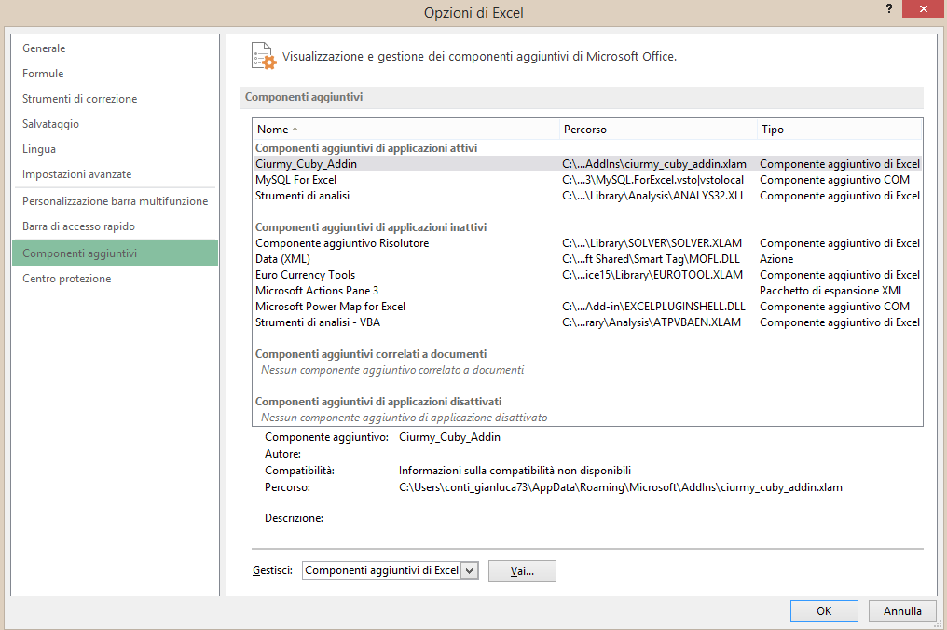
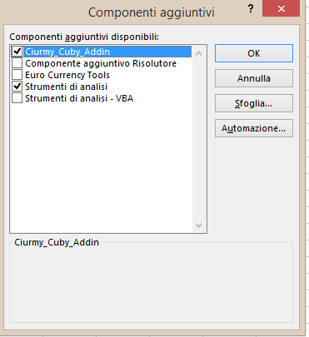
Add the Addin to additional component of Excel
Go to Excel Options
Go to additionals components in options
Add the Addin ‘Ciurmy_Cuby_Addin’

Slide 3
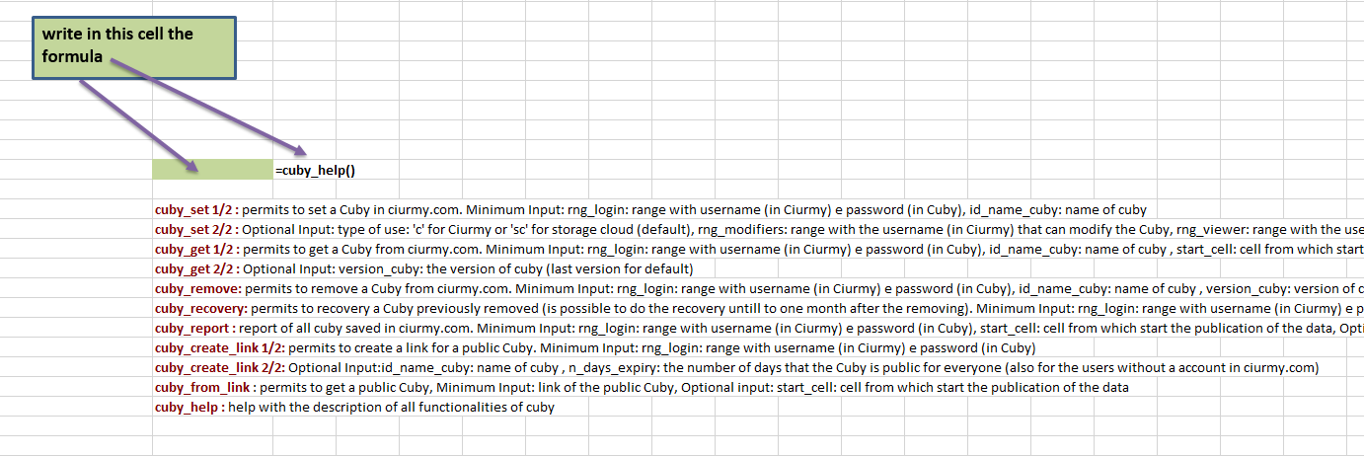
cuby_help()
Type in a cell of the sheet: cuby_help()
You see the params for every formula

Slide 4
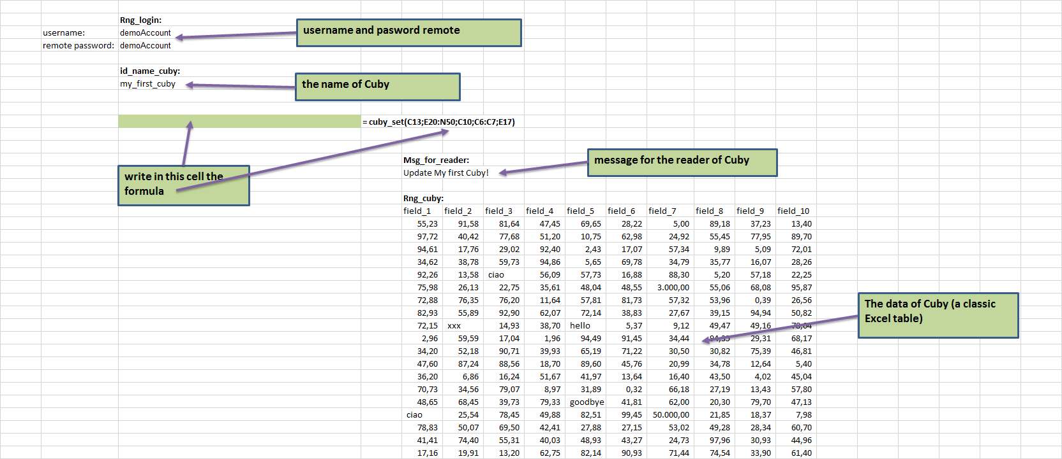
cuby_set()
To store a tables of data (called Cuby):
Type in a cell of the sheet: cuby_set()
Put inside the formula:
Login parameters
The name of cuby (id_name_cuby)
The range of tables
a message for the reader (optional)

Slide 5
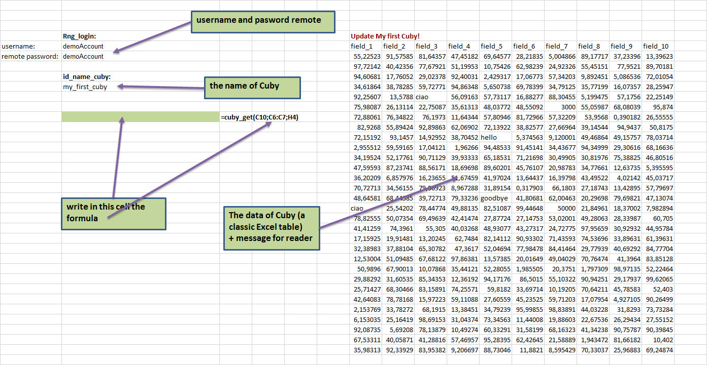
cuby_get()
Tot get the Cuby stored:
Type in a cell of the sheet: cuby_get()
Put inside the formula:
Login parameters
The name of cuby (id_name_cuby)

Slide 6
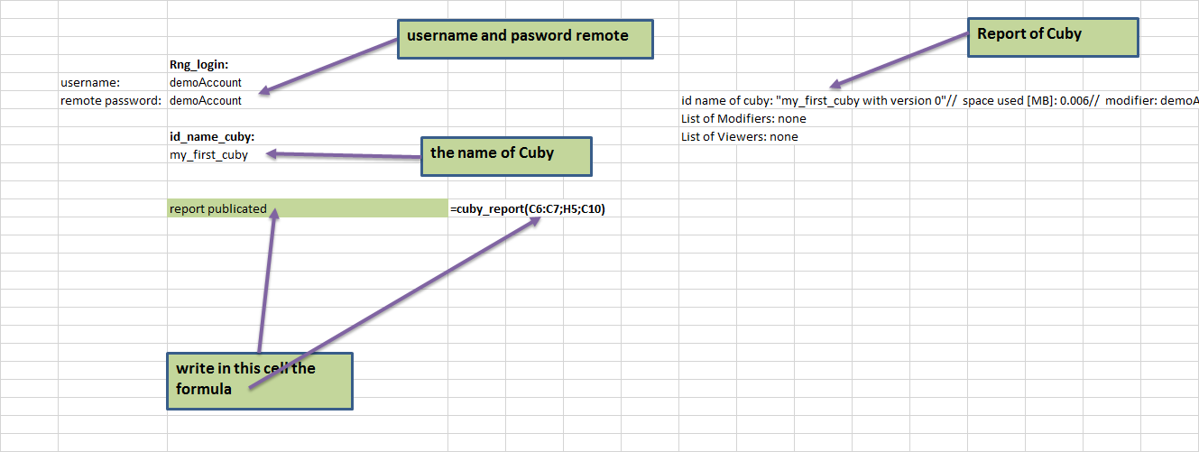
cuby_report()
To see all Cuby or one in particular:
Type in a cell of the sheet: cuby_report()
Put inside the formula:
Login parameters
In id_name_cuby : the name of cuby or nothing (to see the report of all Cuby stored)

Slide 7
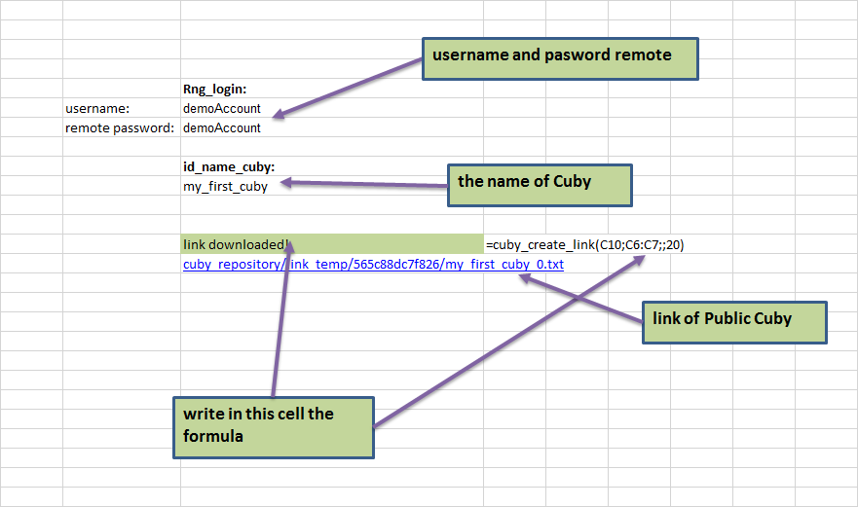
cuby_create_link()
To store a public Cuby that all can see (also for the users not registered in Ciurmy):
Type in a cell of the sheet: cuby_create_link()
Put inside the formula:
Login parameters
In id_name_cuby : the name of cuby
The number of days in which the Cuby is public

Slide 8
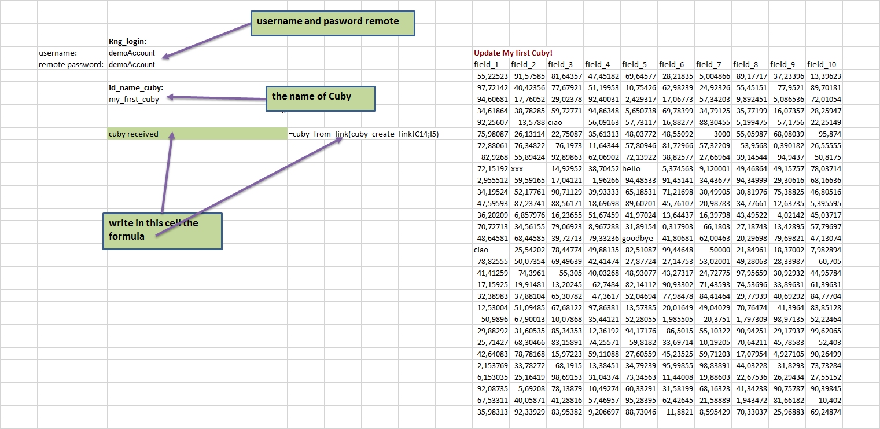
cuby_from_link()
To get a public Cuby:
Type in a cell of the sheet: cuby_from_link()
Put inside the formula:
link of Cuby (this link has been created using cuby_create_link)
Choose the cell for writing of the Cuby

